Slide 1
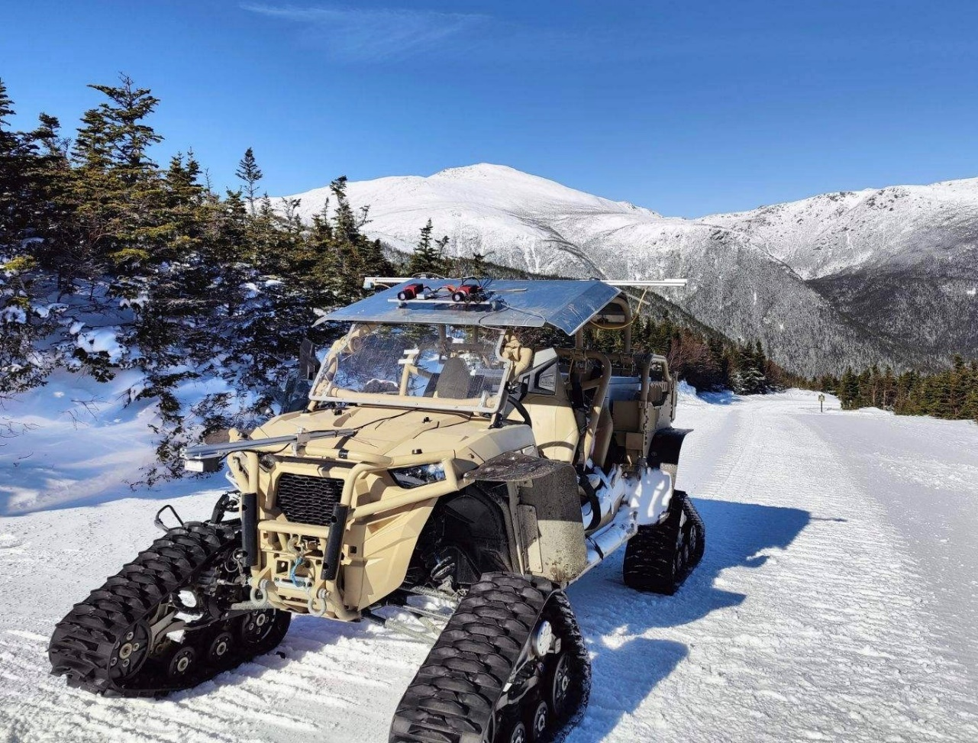
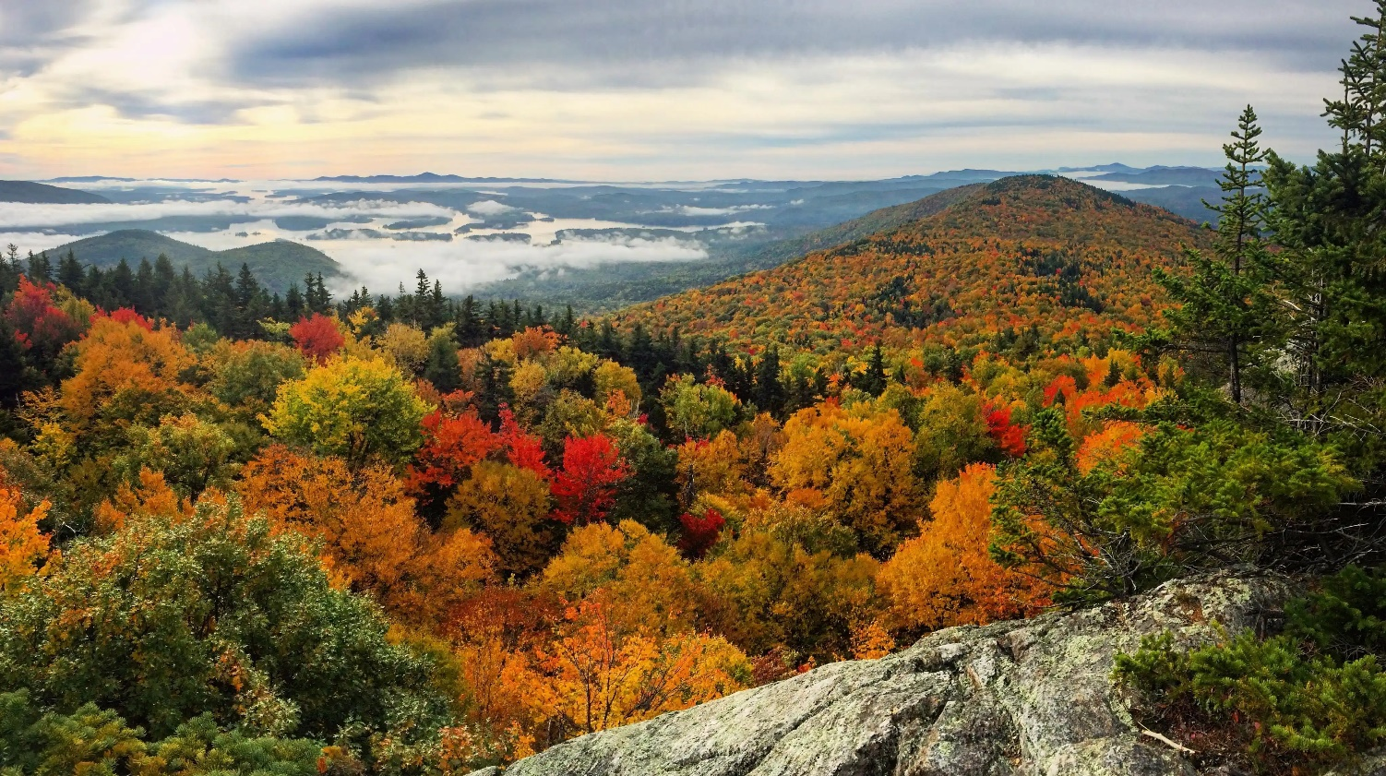
55th Americas Regional Conference of the ISTVS
Lebanon, New Hampshire, USA
October 6 to 9, 2025

Slide 2
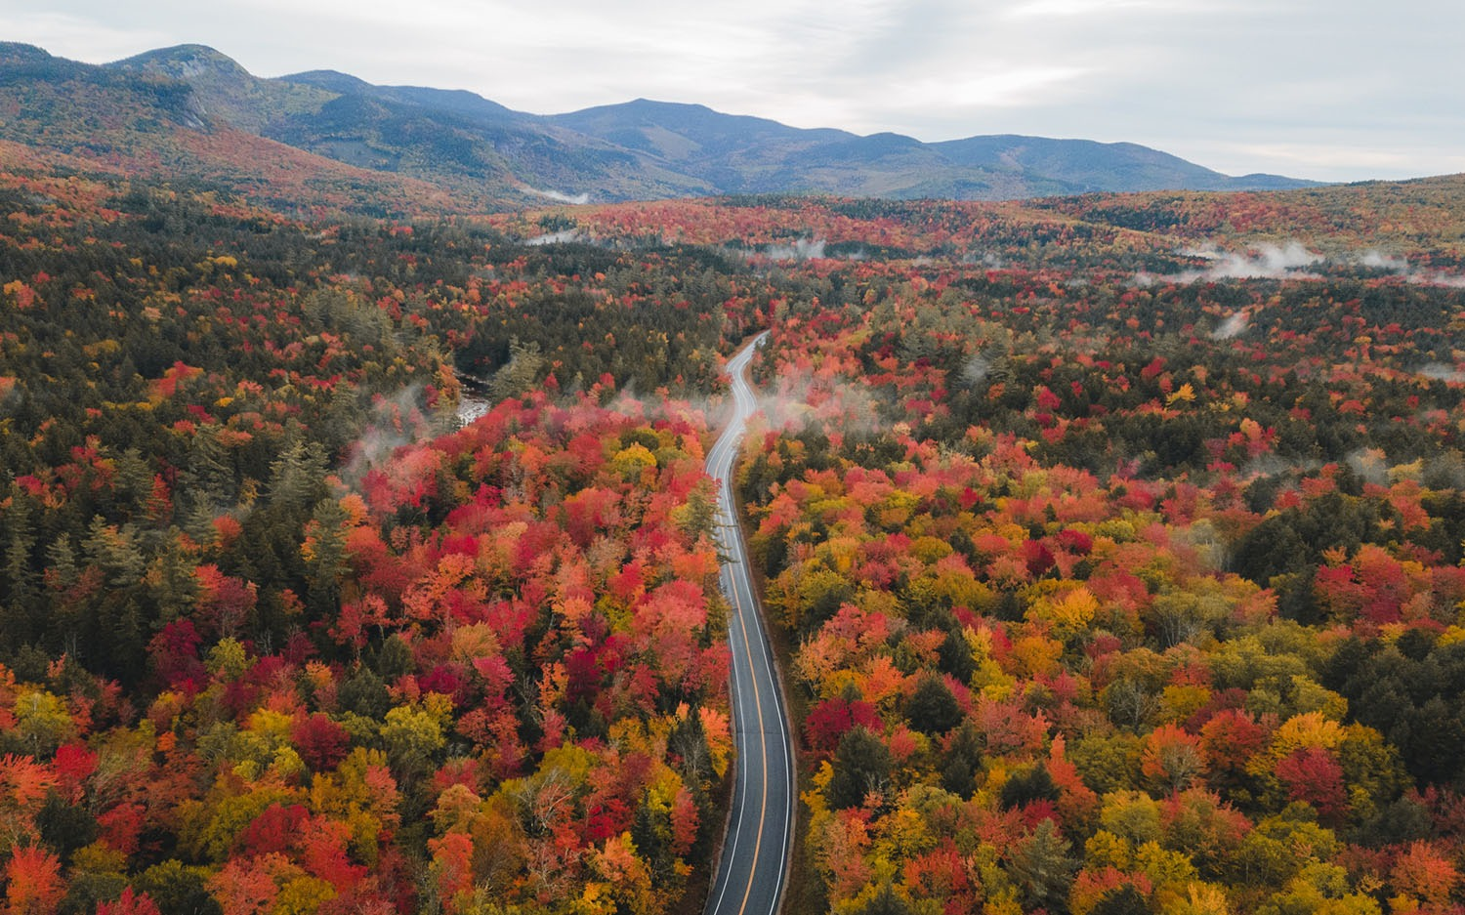
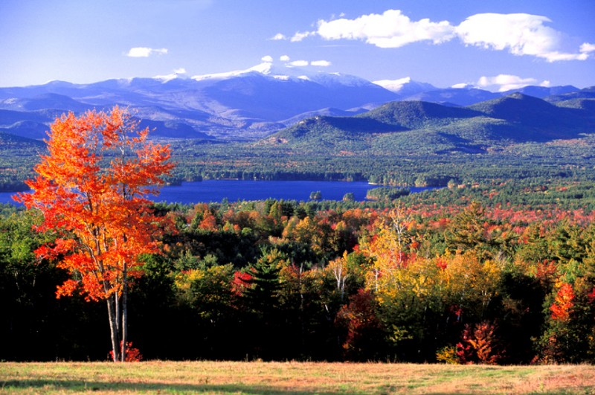
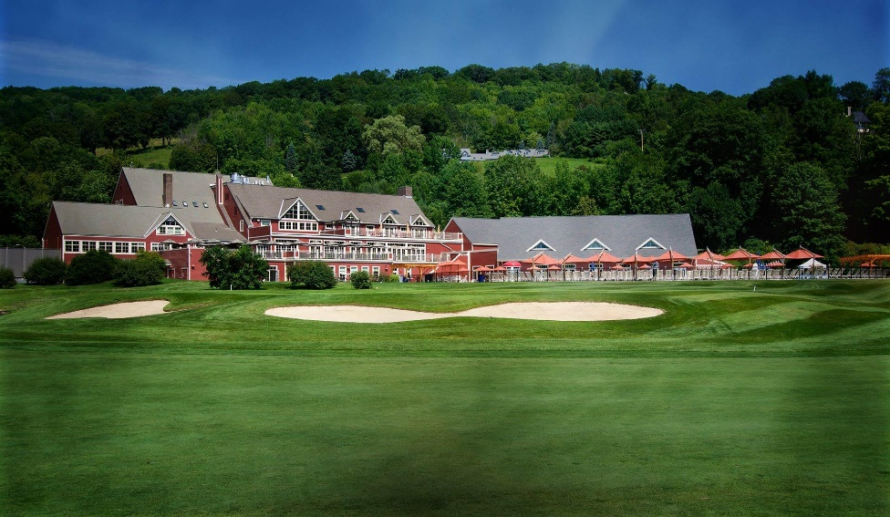
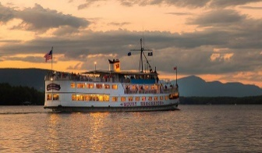
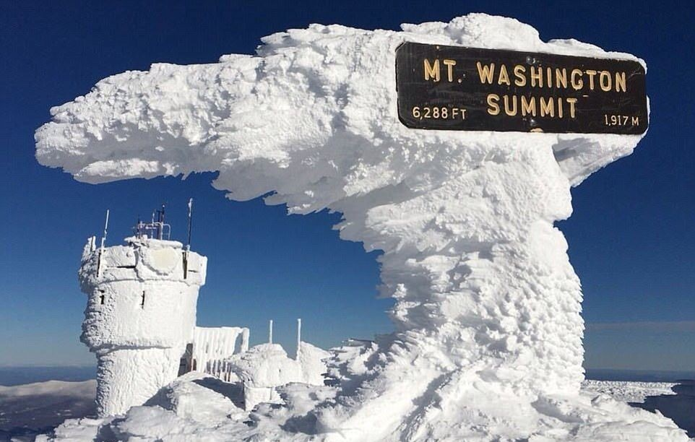
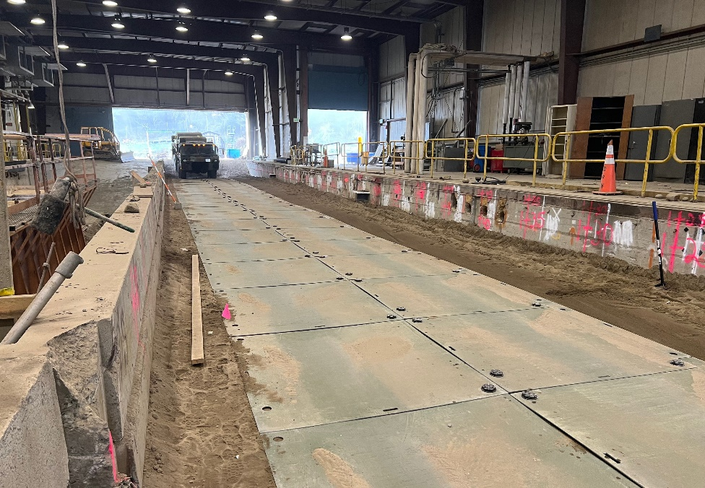
Highlights
Famous Fall Foliage
Situated between New Hampshire and Vermont Mountain ranges
Autumn is clear and dry, although weather may vary
Pre and Post Conference Technical Tours

Slide 3
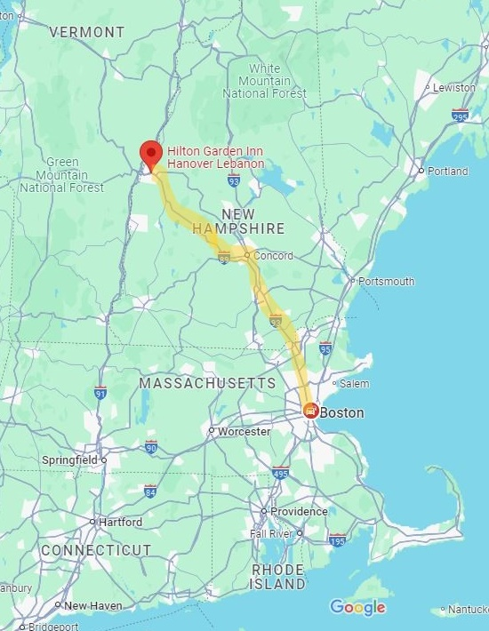

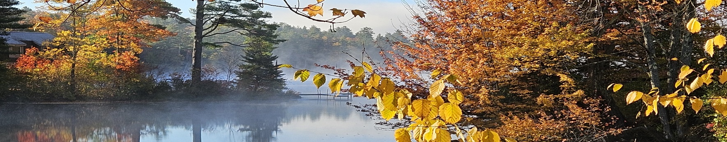

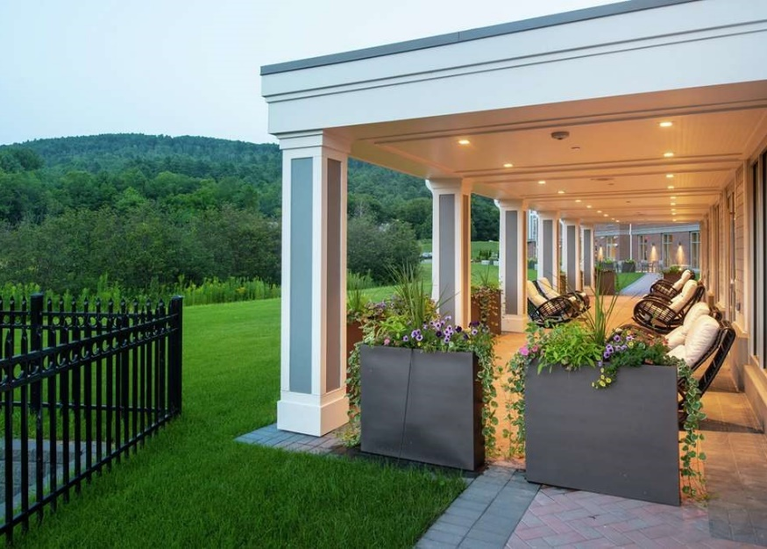


Getting to Lebanon, New Hampshire
Direct bus service available from Boston Logan International Airport (BOS) via Dartmouth Coach bus service
BTV
2 hours drive from Boston, Massachusetts
1.5 hours drive from Burlington, Vermont
LEB
MHT
BOS
BDL

Slide 4
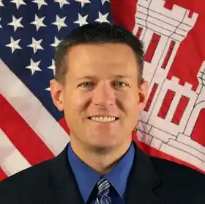
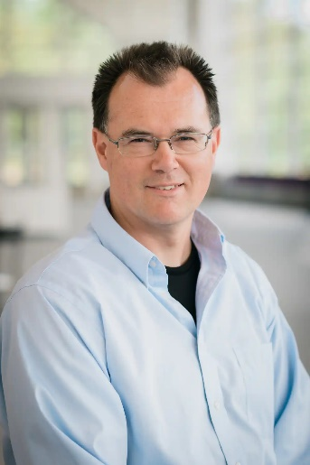
Mr. John B. Eylander
Dr. Paul van Susante
Mr. Eylander was named Chief Technology Officer for the formerly named Air Force Weather Agency before coming to ERDC
Background is focused on weather, surface hydrology, land surface modeling, land-atmosphere interactions, high performance computing and satellite remote sensing
Assistant professor at Michigan Technological university
Founder of Planetary Surface Technology Development Lab(PSTDL)
Actively researching, developing and testing technologies under lunar and mars environment conditions

Slide 5



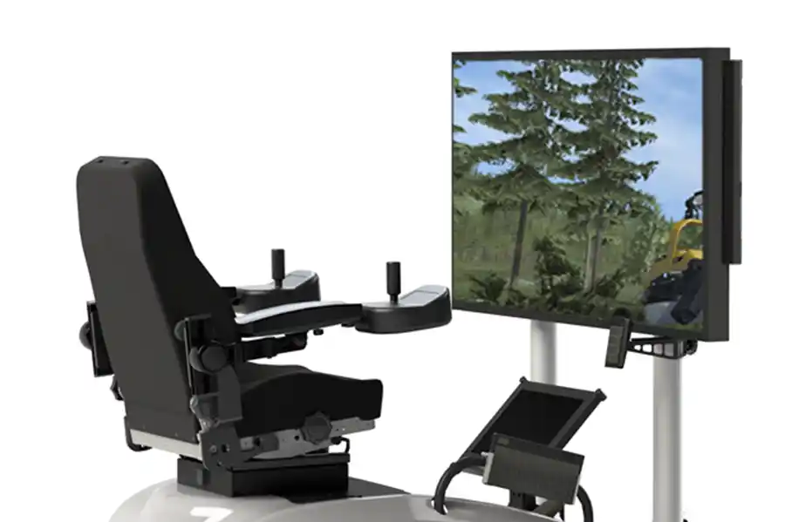
Algoryx
Global leader in real-time physics simulation for complex machinery, vehicles, and robotics
Their technology is widely use in construction, mining, forestry, agriculture, and defense
Planning on using AI-driven control systems for planetary exploration

Slide 6
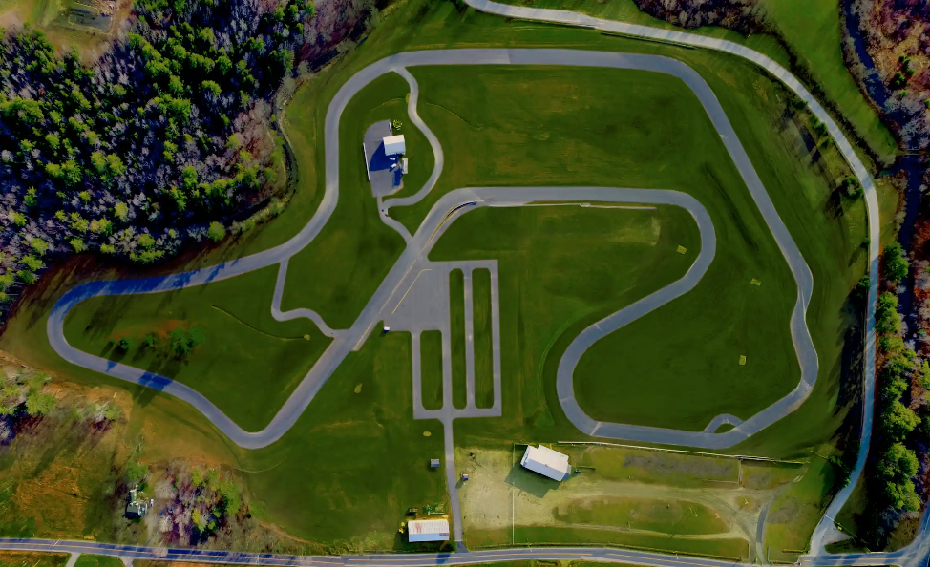
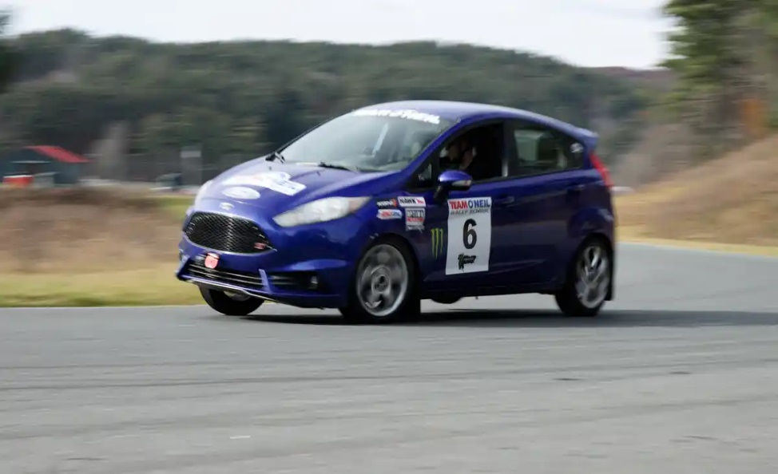
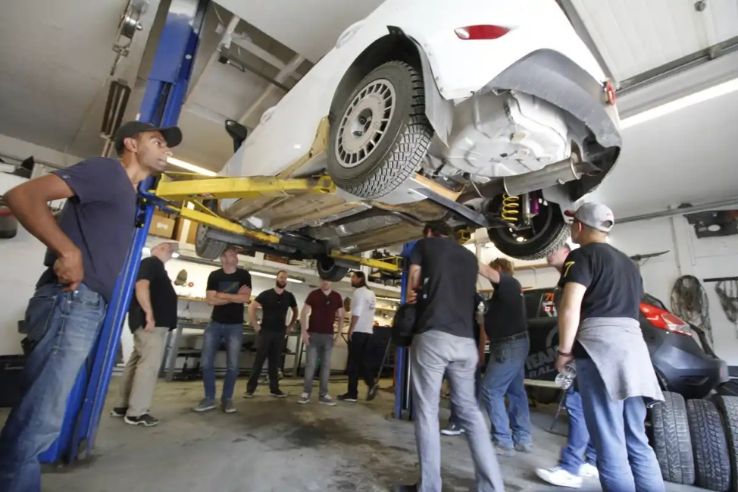
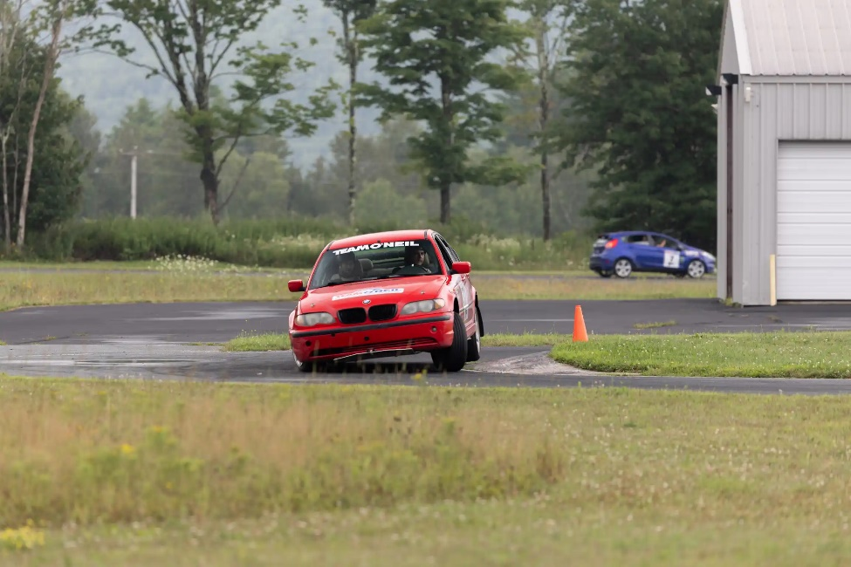
Team O’Neil Demo
Demo highlighting vehicle dynamics and soft soil mobility
Introduction to Rally cars and their modifications for high-speed, paved and unpaved- road performance
Included is a ride-along asphalt rally experience (1 to 3 per vehicle)

Slide 7
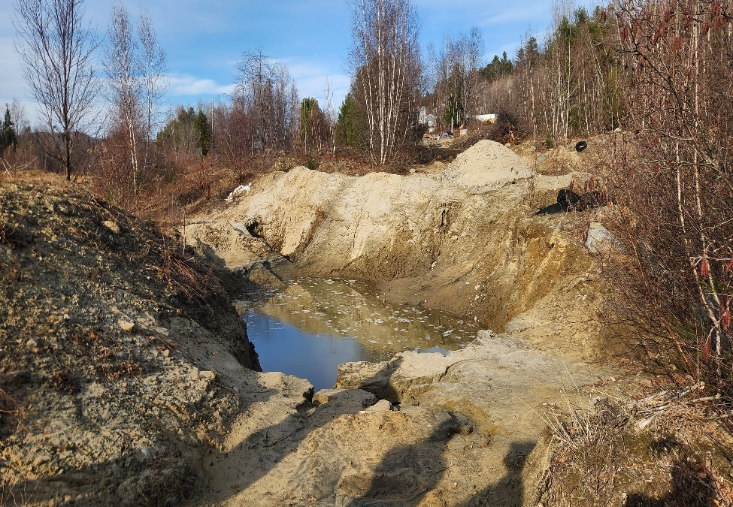
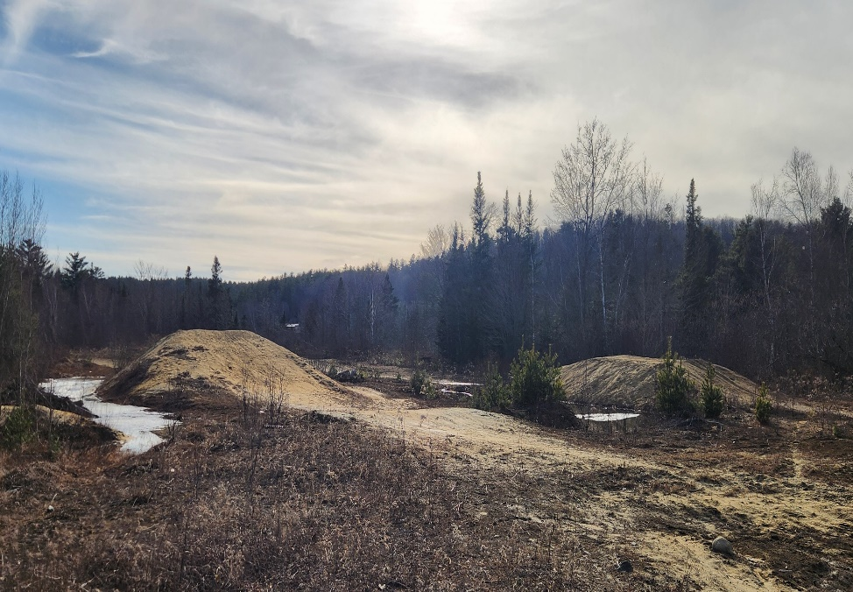
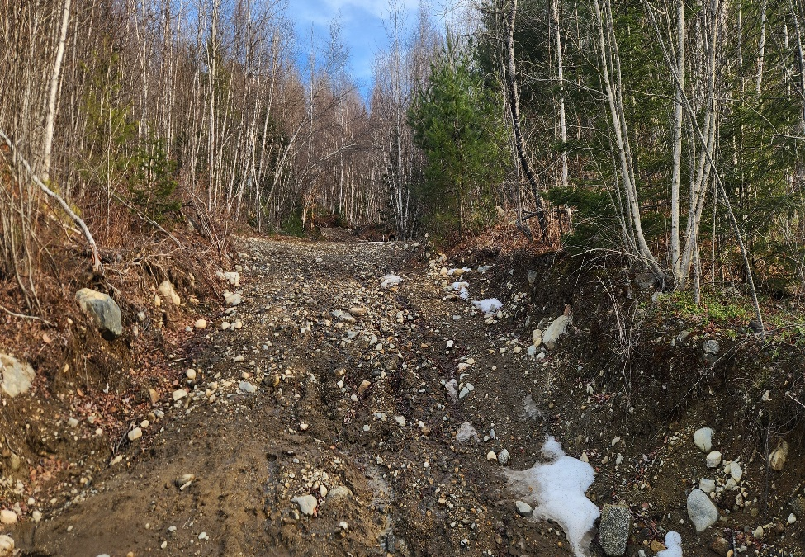
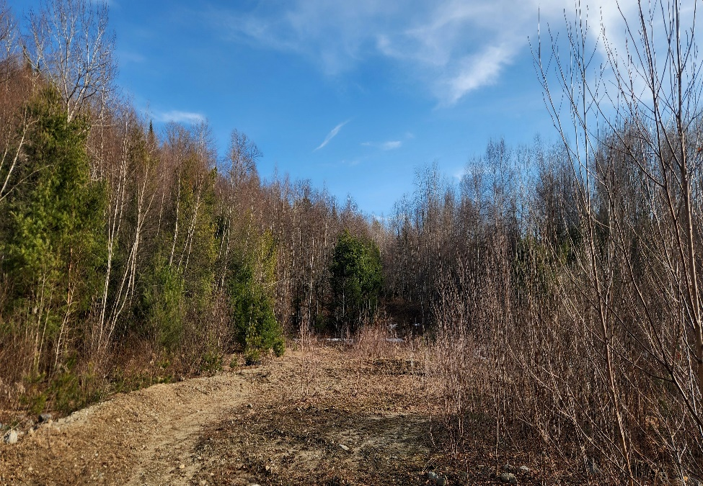
Autonomy Demo
Demo highlighting state of the art off-road autonomy techniques
Workshop bringing together industry, government, and academia
Capability documentation in follow-on journal article

Slide 8
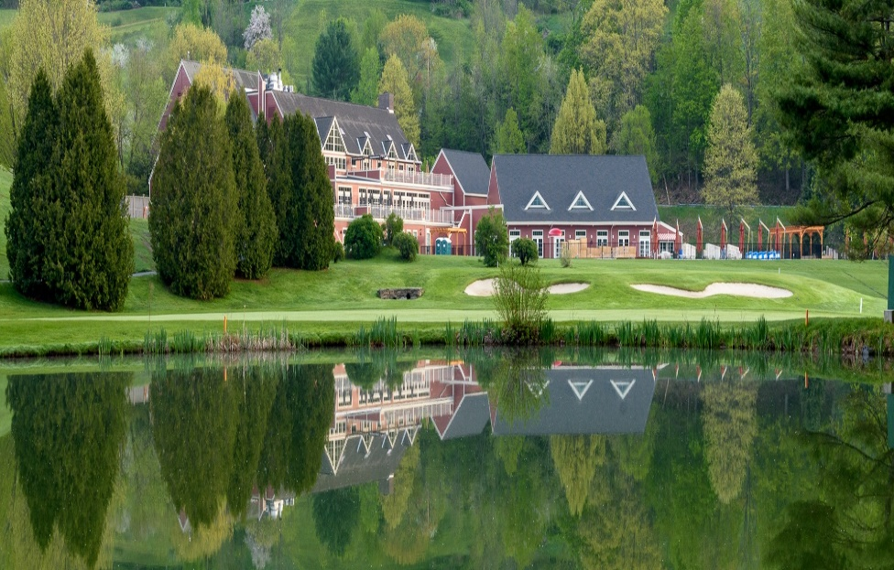
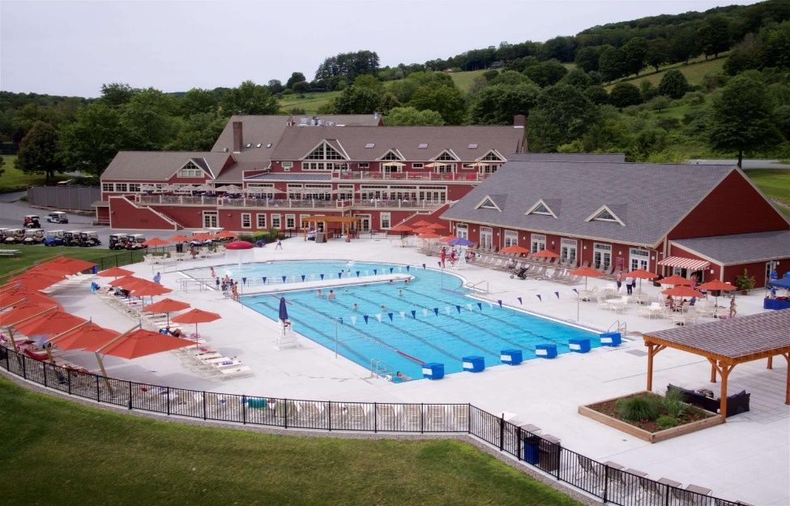
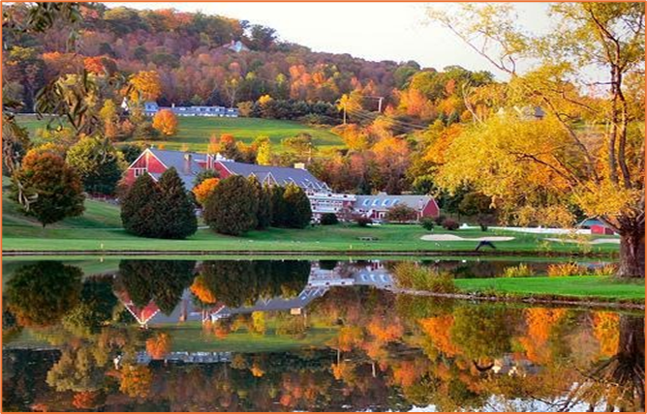
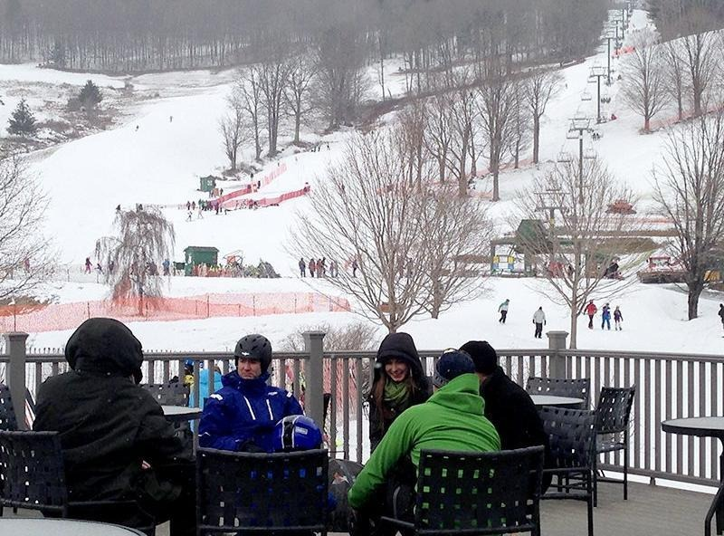
Banquet
Venue: Quechee Club
Surrounded by amazing sights and even better people the quechee club is the hidden gem of Hartford
With two golf courses, tennis courts and their own ski mountain in the winter the quechee club is truly amazing

Slide 9
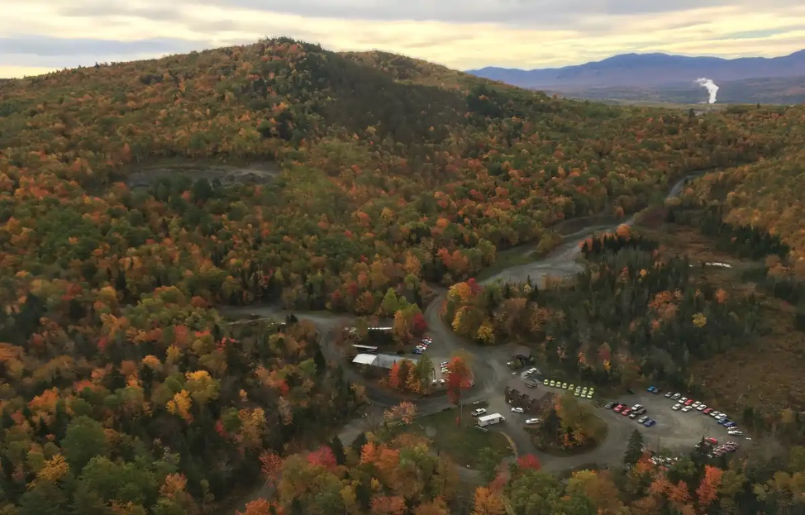
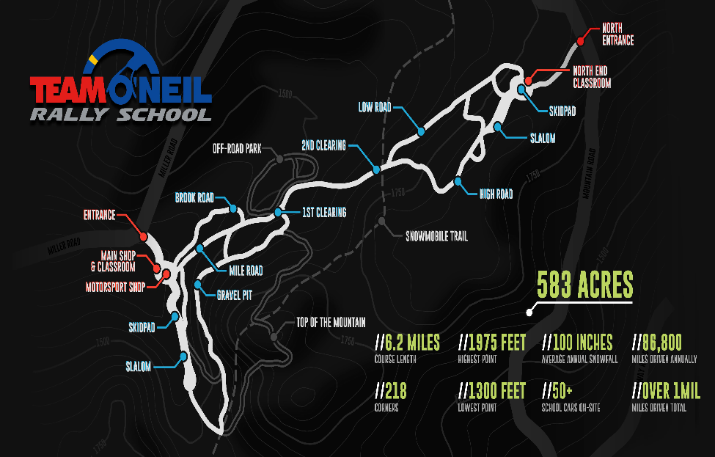
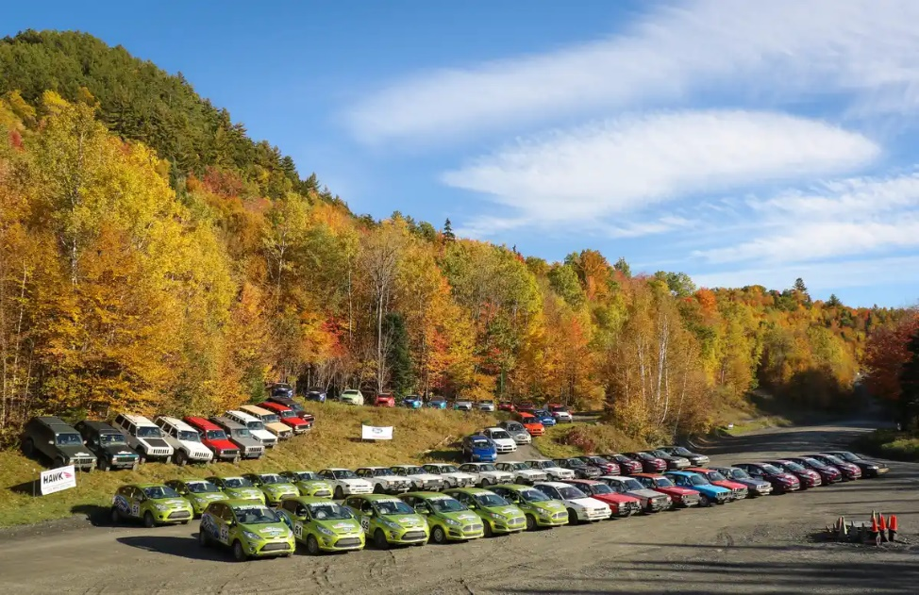
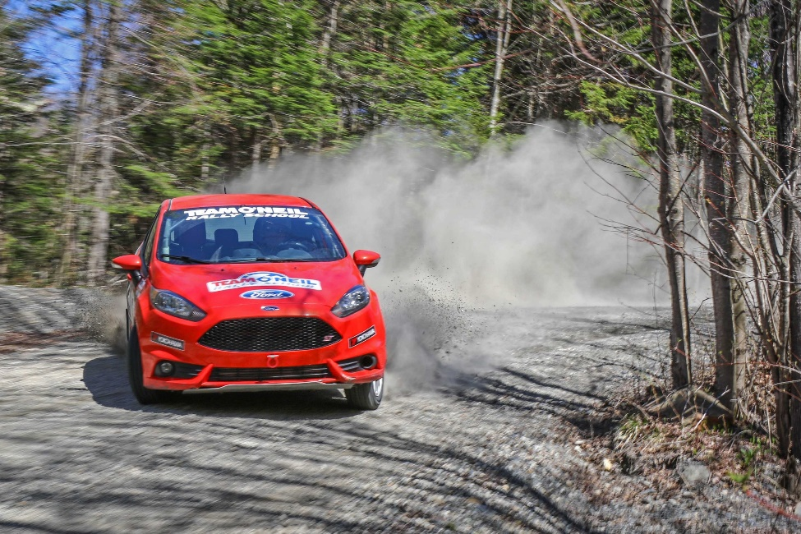
Team O’Neil Tour
Team O’Neil is the world leader in advanced vehicle control driver training on all road surfaces
See their fleet of vehicles, tour of the property and meet the instructors
Potentially see students conducting training and maybe get to ride in a rally car

Slide 10

For additional conference information see our website:
2025.istvs.org
We look forward to seeing you in October 2025: ISTVS2025@istvs.org
Conference Chair: Michael Parker
Conference Planner: Sally Shoop
Conference Planner: Lindsey Wetzel
Conference Tour: Cliff Witte
June 15, 2025 – Early Bird registration closes

